Slide 1
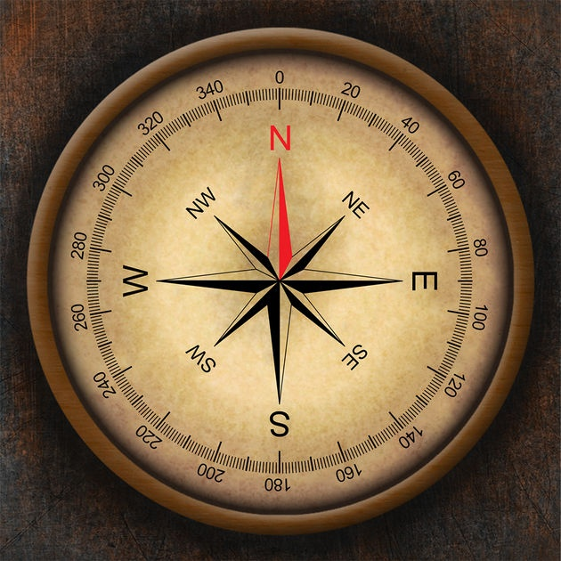
COMPASS

Slide 2
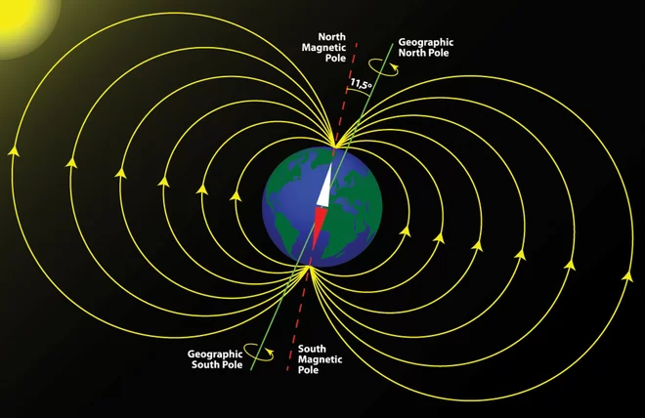
The compass is an instrument used for navigation and orientation on Earth’s surface using the magnetic poles
The Earth’s geographical poles are different than the magnetic ones for 11,5 °. The difference is called magnetic declination

Slide 3
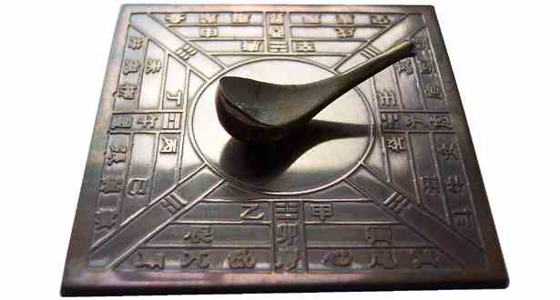
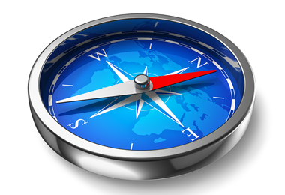
The first compasses were made out of lodestone (a naturally magnetized ore of iron) they were built around 300-200 BC
Later, iron was used and the compass evolved with humans as it became what it is today

Slide 4
There are many types of compasses (here are some of the most important :
Magnetic compass
Gyro compass
Thumb compass
Etc.

Slide 5
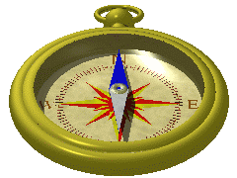
MAGNETIC COMPASS
- It has a magnetic element (needle or card) that aligns itself with magnetic lines of Earth's magnetic field to point to the magnetic poles of the Earth

Slide 6
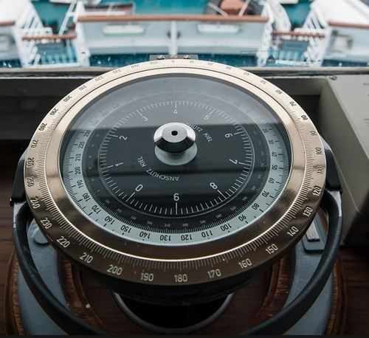
GYRO COMPASS
- It has a rapidly spinning wheel whose rotation interacts with the rotation of the earth until its axis of rotation is parallel with the Earth's. This compass points to the true (geographic) poles.

Slide 7
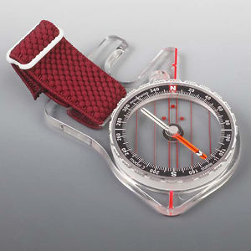
THUMB COMPASS
- This is a variant of a normal compass but smaller. It is fixed on the thumb which then leaves one hand free.

Slide 8
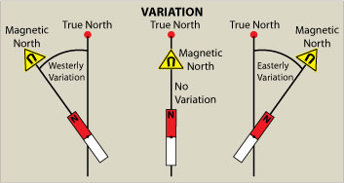
At sea, a ship's compass must also be corrected for errors, called deviation, caused by iron and steel in its structure and equipment.
The correction must be made by someone who knows about it and is very experienced (for an example our prof. Jurica Pešo)

Slide 9
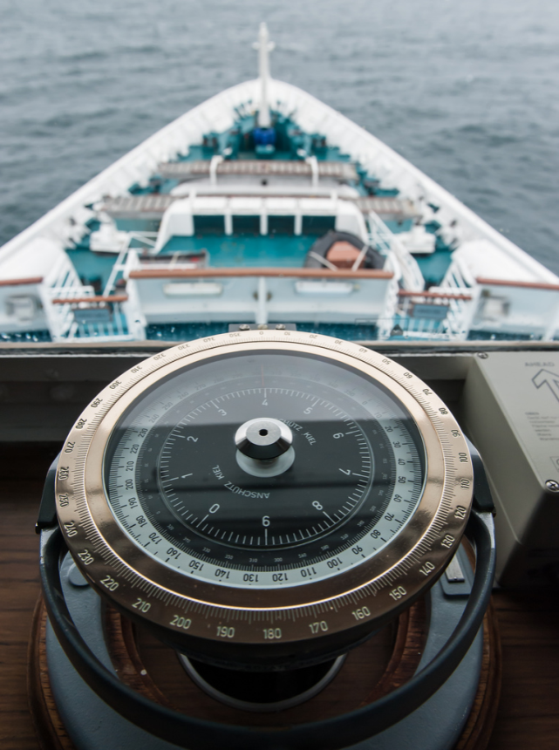
- Compasses are one of the most important and best inventions of human kind. They are very helpful and will most likely evolve even more in the future.

Slide 10
THANK YOU FOR YOUR ATTENTION
Made by: Jakov Bezić

