Slide 1
LNG CARRIERS
Napravio: Matija Bukić, 2.c

Slide 2
About the ship
LNG(Liquefied Natural Gas)
It is a tank ship designed for transporting liquefied natural gas
A typical LNG carrier has four to six tanks located along center-line of the vessel
Surrounding the tanks is a combination of ballast tanks
Temperature in the tanks needs to be -162°C(-260°f)

Slide 3
About the ship
These vessels, unlike other tankers, have a propulsion system which is fueled with natural gas, thus, emitting lesser greenhouse gases

Slide 4
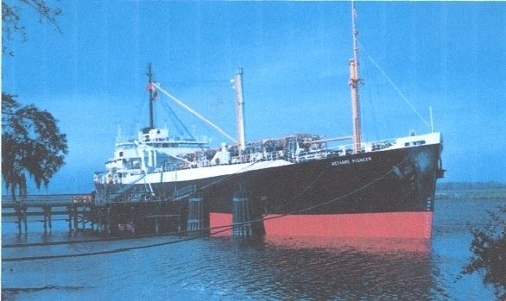
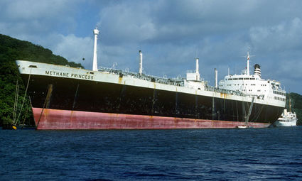
History
The first LNG carrier Methane Pioneer (5,034 DWT) left the Calcasieu River on the Louisiana Gulf coast in 1959
Carrying the world's first ocean cargo of LNG, it sailed to the UK where the cargo was delivered

Slide 5
Classification of LNG carriers
LNG vessels can be classified in four categories in term of cargo contained system:
Moss( Spherical-type A)
IHI(Prismatic-Type B)
TGZ MARK III
GT96

Slide 6
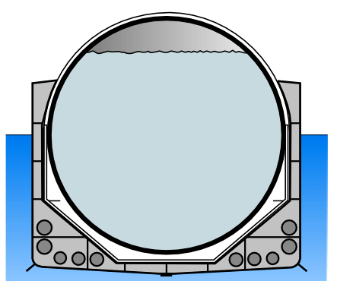
Moss( Spherical-type A)
This system is named after a Norwegian company that designed them( Moss Maritime)
Most of this type of vessels have around 4-5 tanks on ship

Slide 7
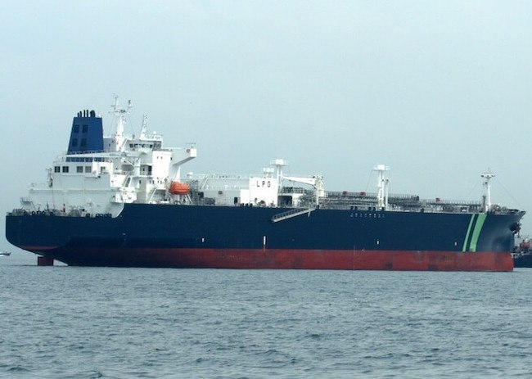
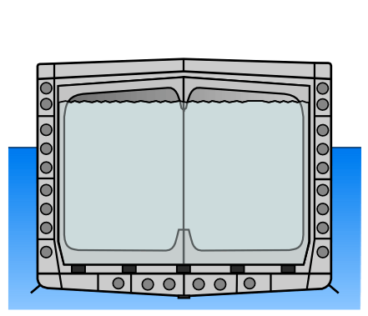
IHI( Prismatic-type B)
It is designed by Ishikawajima-Harima Heavy Industries which are employed in only 2 vessels
Because of the several incidents in the past, these tanks were constructed to sustain internal accident damage due to internal equipment releases

Slide 8
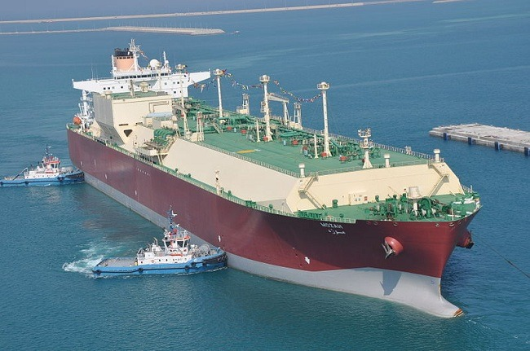
TGZ MARK III
It is designed by Technigaz
It consists of waffles, the primary barrier is made up of stainless steel of 12mm thickness All these barriers are supported by the ship’s structure from outside.

Slide 9
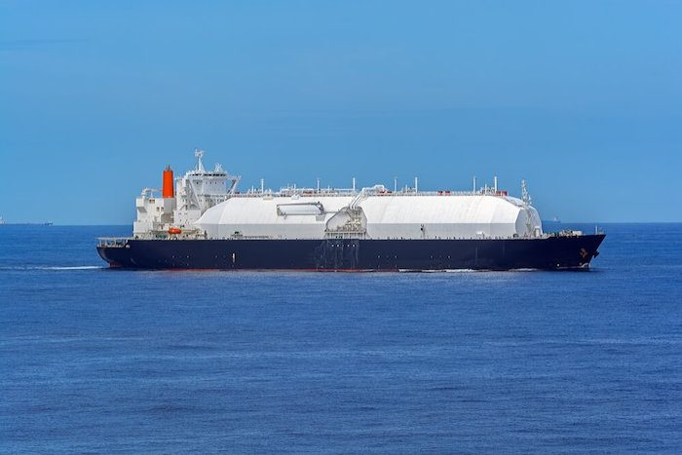
GT96
It is designed by Gaztransport
consists of primary and secondary
membranes made up of a material
Invar which has no thermal contraction
Here the plywood boxes filled with perlite
is used for insulation which is flushed with
nitrogen gas.

Slide 10
Thank you for your time

